Slide 1


01
Team 14 | Hudson, Nevada, Patsy

Slide 2


02
Agenda
Challenge Statement
Problem Exploration
Solution
Business Value
Q & A
Team 14 | AmpHacks 2020

Slide 3

03
Team 14 | AmpHacks 2020
Challenge:
… create meaningful solutions that make Canadian lives better?
How can we help Canadian SMEs?
Notes:
Almost 1/3 businesses have closed due to COVID-19.
Those that stayed open have been impacted by reduced revenue and disrupted business continuity, all while managing the stress of cash flow concerns.
How can we help Canadian SMEs?

Slide 4
04
Problem Exploration
Maintaining Profitability
Financing Company Expansion
Profits on a consistent basis is a challenge for approximately 44.7% of Canadian SMEs
21% of Canadian SMEs are challenged when it comes to securing financing for large projects
Employment Issues
Around one-third of Canadian employers surveyed admitted to facing difficulties in hiring the unskilled workers they need due to labour scarcity
Profitability identified as a key driver.
Notes:
(source: 2018 Talent Shortage report by Manpower Group Inc )
(Q3, 2017 Survey The future of business survey)

Slide 5
05
Team 14 | AmpHacks 2020
Our Solution
Increasing accessibility to personalized data insights by:
Isolating key metrics that drive profitability
Analyzing and projecting these metrics based on historical, similar, and macro data
Better utilizing existing data produced by businesses
Measuring immediate status
Recommending strategic actions
E.g. 34 days left in business with current cash reserves
E.g. alter product mix in light of winter + COVID trends

Slide 6

06
Features
Calculate current financial health
Actionable insights
Growth tips
Data visualization
Team 14 | AmpHacks 2020

Slide 7
07
Future Extensions
Direct integration with business databases / POS APIs.
Secure login.
More intricate projections.
Team 14 | AmpHacks 2020

Slide 8


08
Insite
V.S. Competitors
Bank Advisors
Slower process and less convenient.
Not accessible daily.
Accounting Software
No tailored recommendations.
Less specific.
Team 14 | AmpHacks 2020

Slide 9
09
Team 14 | AmpHacks 2020
Business Value
Larger consumer base and potential lifetime customers
Provide business funding (line of credit, commercial credit card, commercial loan)
Extend the RBC Venture project Canada United
Involvement and growth potential with companies
Help Canadians! Help Canada recover

Slide 10
10
Team 14 | AmpHacks 2020
Q & A

Slide 11
10
Team 14 | AmpHacks 2020
Appendix

Slide 12
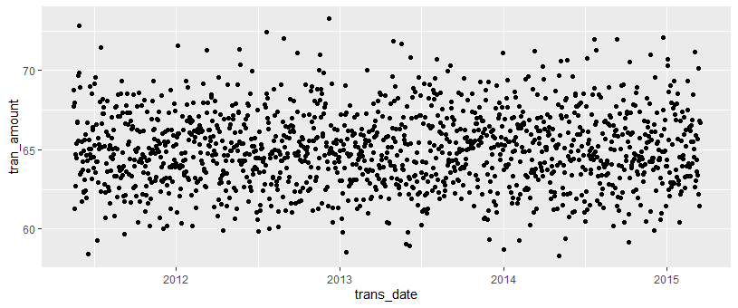
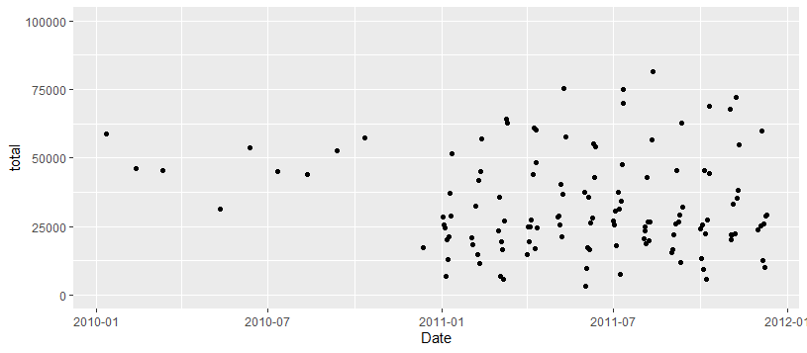
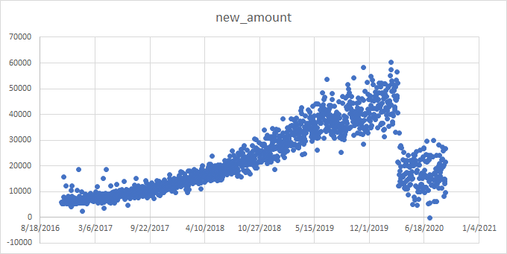
Data Manipulation

